Slide 1
HW1: Solutions
Shengquan Wang

Slide 2
Q3.UCS
10₈ | 8₆ | 5₄ | 1₂ | 0₀
13₉ |  |  | 3₃ | 2₁
16₁₀ | 15₁₂ | 12₁₀ |  | 4₂
14₁₁ | 11₉ | 9₇ | 7₅ | 6₃
d
c
b
a
1
2
3
4
5

Slide 3
Q3.GBFS
6₄ | 5₂ | 3₄ | 1₆ | 0₈
7₃ |  |  | 4₅ | 2₇
8₂ | 9₀
10₅
d
c
b
a
1
2
3
4
5

Slide 4
Q4.DFS
7 | - | 8
4 | 6 | 2
3 | 1 | 5
0
#1
- | 7 | 8
4 | 6 | 2
3 | 1 | 5
2
7 | 8 | -
4 | 6 | 2
3 | 1 | 5
2
7 | 6 | 8
4 | - | 2
3 | 1 | 5
3
#2
7 | 6 | 8
- | 4 | 2
3 | 1 | 5
5
7 | - | 8
4 | 6 | 2
3 | 1 | 5
7 | 6 | 8
4 | 2 | -
3 | 1 | 5
5
7 | 6 | 8
4 | 1 | 2
3 | - | 5
6
#3
7 | 6 | 8
4 | 1 | 2
- | 3 | 5
8
7 | 6 | 8
4 | - | 2
3 | 1 | 5
7 | 6 | 8
4 | 1 | 2
3 | 5 | -
8
#4
7 | 6 | 8
4 | 1 | 2
3 | - | 5
7 | 6 | 8
4 | 1 | -
3 | 5 | 2
9

Slide 5
Q4.A*
7 | - | 8
4 | 6 | 2
3 | 1 | 5
0 |  | 35
#1
(2*1+3*2)+(2*1+3*1)+(2*2+3*2)+(2*2)+(0)+(1*1)+(1*2)+(1*1+2*2)=35
- | 7 | 8
4 | 6 | 2
3 | 1 | 5
2 |  | 37
#4
7 | 8 | -
4 | 6 | 2
3 | 1 | 5
2 |  | 33
#2
7 | 6 | 8
4 | - | 2
3 | 1 | 5
3 |  | 36
7 | - | 8
4 | 6 | 2
3 | 1 | 5
4 | 7 | 8
- | 6 | 2
3 | 1 | 5
5 |  | 38
7 | - | 8
4 | 6 | 2
3 | 1 | 5
7 | 8 | 2
4 | 6 | -
3 | 1 | 5
5 |  | 30
#3
7 | 8 | 2
4 | - | 6
3 | 1 | 5
7 |  | 32
7 | 8 | -
4 | 6 | 2
3 | 1 | 5
7 | 8 | 2
4 | 6 | 5
3 | 1 | -
8 |  | 31

Slide 6
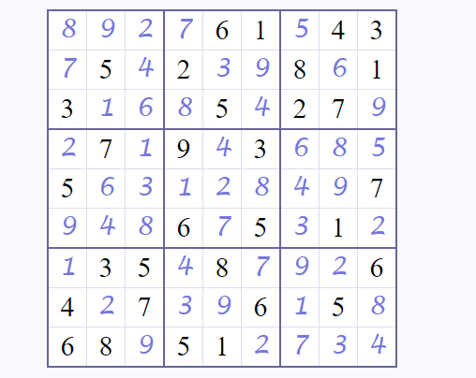
Q5

Slide 7
Q6
 | Q
 |  |  | Q
 |  |  |  |  | Q
Q
 |  | Q
 |  |  |  | Q
 |  | Q
 |  |  |  |  | Q
 | Q
 |  |  |  | Q
Q
 |  |  | Q

Slide 8
Q7
O | O | X
 | X
O | X
0
O | O | X
 | X | X
O | X
-1
O | O | X
 | X
O | X | X
-1
O | O | X
X | X
O | X
0
O | O | X
O | X | X
O | X
-1
O | O | X
 | X | X
O | X | O
1
O | O | X
 | X | O
O | X | X
0
O | O | X
O | X
O | X | X
-1
O | O | X
X | X | O
O | X
0
O | O | X
X | X
O | X | O
1
O | O | X
X | X | X
O | X | O
1
O | O | X
X | X | O
O | X | X
0
O | O | X
X | X | O
O | X | X
0
O | O | X
X | X | X
O | X | O
1

Slide 9
Q8.a
Max
9
Min
7
9
Max
7
8
Min
7
3
4
8
Max
7
11
3
10

Slide 10
Q8.b
Max
9
Min
X
9
Max
X
X
Min
X
X
X
4
Max
X
X
X
7

Slide 11
Q9
10.5625
H: 75%
T: 25%
H
T
9.5
13.75
6.5
9.5
5.25
13.75
H
T
H
T
H
T
H
T
6
8
11
5
4
9
16
7
6
14
13
5
7
11

